Slide 1
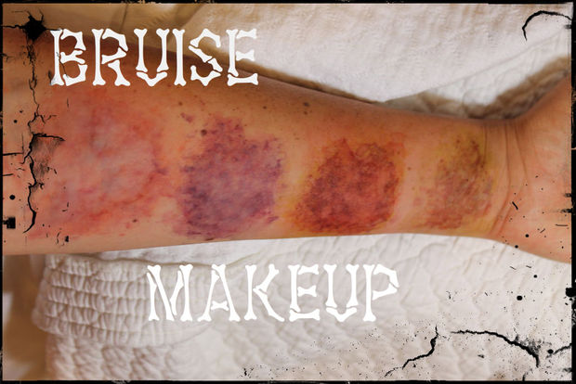

Slide 2
Bruises are caused when blunt trauma breaks the capillaries just beneath the skin, flooding the dermis with blood. As the hemoglobin in the blood breaks down and disperses, bruises change color and fade. Today I’m going to be demonstrating how to create bruises across the many stages of healing.
You need to ask yourself:
1. What caused the bruise?
Bruises will initially form around the area of impact. Think about the shape of the object that caused the bruise. For example, if your character was struck by the end of a baseball bat, the bruise will be large and shaped somewhat like the end of a baseball bat.
2. When was the incident that caused the bruise?
If you are depicting someone who has just been in a fight, their bruises will be mainly red and blue tones. As the bruise heals, the shape, size, and color of the bruise changes, so be sure to take the time frame into consideration.
3. How hard was the impact and on what part of the body?
Bruises from being struck by a vehicle look very different from bruises caused by a fistfight. Also, if the impact was especially hard and on a delicate area directly over a bone, like on the cheekbone or the browbone, skin will often split open from the force of impact. Use references for the specific look you’re going for—just go to Google Images and search “bruises from car crash” (or whatever specific incident you’re trying to recreate) to help keep that air of authenticity.
Also take into consideration the person's skin tone, age, and health, which all impact the way they will bruise.

Slide 3
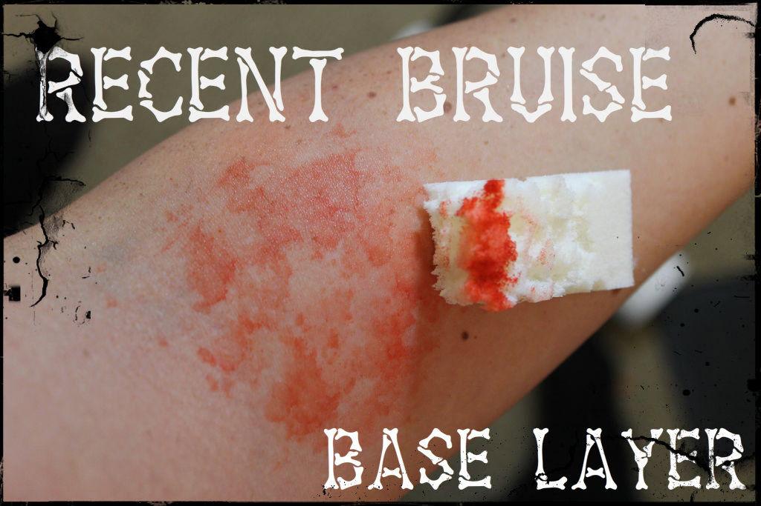
BRUISES ARE CAUSED WHEN BLUNT TRAUMA BREAKS THE CAPILLARIES JUST BENEATH THE SKIN, FLOODING THE DERMIS WITH BLOOD. AS THE HEMOGLOBIN IN THE BLOOD ALSO TAKE INTO CONSIDERATION THE PERSON'S SKIN TONE, AGE, AND HEALTH, WHICH ALL IMPACT THE WAY THEY WILL BRUISE.

Slide 4
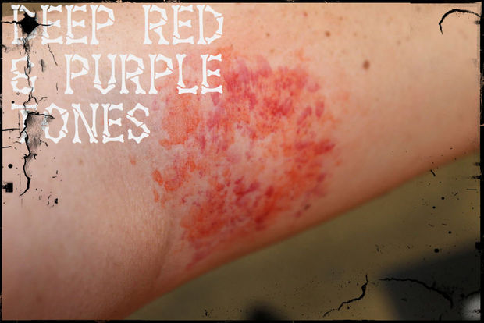
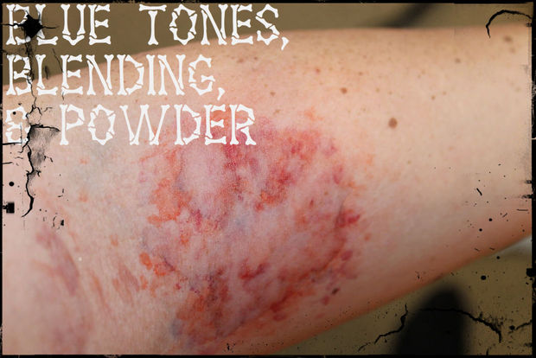
For a recently-acquired bruise, begin with by stippling all over the area with some prime red on your texturized sponge. Then add deeper red tones and finally, some very light blue and/or purple tones. Blend the colors together, by stippling all over the area. Then powder with a light layer of RCMA powder to make the bruise to appear to be beneath the skin and not just sitting on top of it.

Slide 5
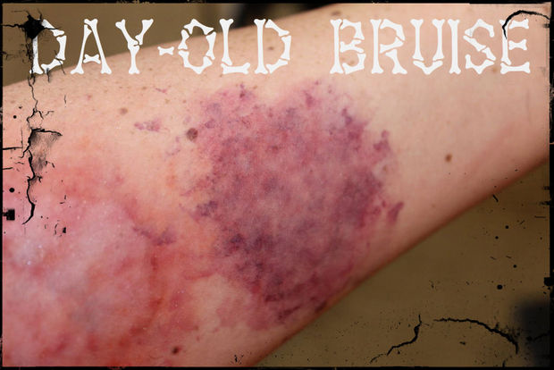
For the day-old (or several days-old) bruise, Begin by stippling a light layer of prime red all over the area, just as before. Then add several heavier layers of deep red, blue, and purple all over the area with texturizing sponges and then powder.

Slide 6
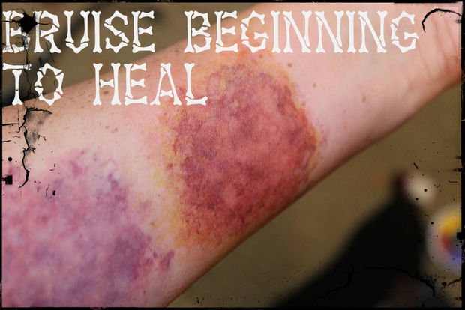
This is a bruise that is just beginning to heal. Begin with a wash of yellow all over the area with a texturizing sponge, then add a few streaks of a yellowish green. On top of that stipple some deep red, purple, blue, and reddish-brown tones then powder.

Slide 7
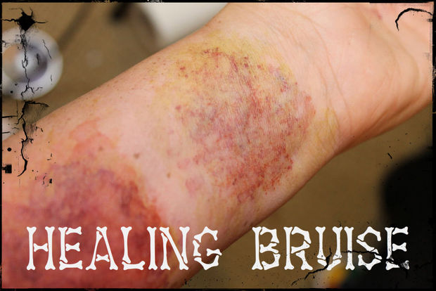
This is a bruise that is further along in the healing process. Begin with a lighter wash of green and yellowish-green tones than in the previous stage of bruising, and add lighter stipples of reddish-brown, purple, blue, and deep red tones, then powder. As the bruise continues to heal, the red, purple, and blue tones will dissipate, leaving more and more of the yellow and green tones before disappearing completely.

Slide 8
You Tube Videos on Bruising
https://www.youtube.com/watch?v=4Wgokk2ktyU - madeyewlook

