Slide 1
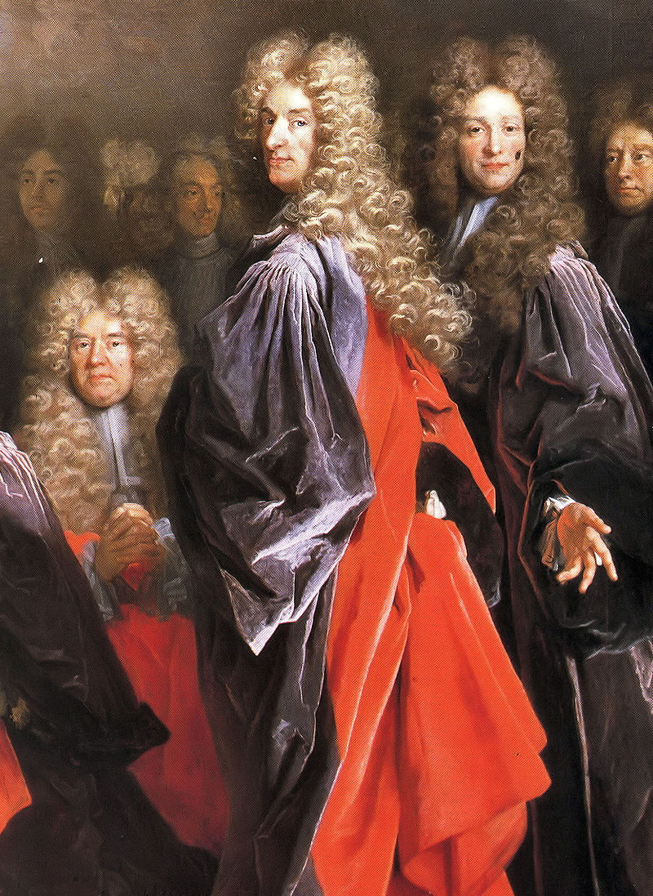
The Comedy of Manners
The Comedy of Manners is a style of comedy that satirizes the behaviour, actions, fashions, and manners of a segment of society.

Slide 2
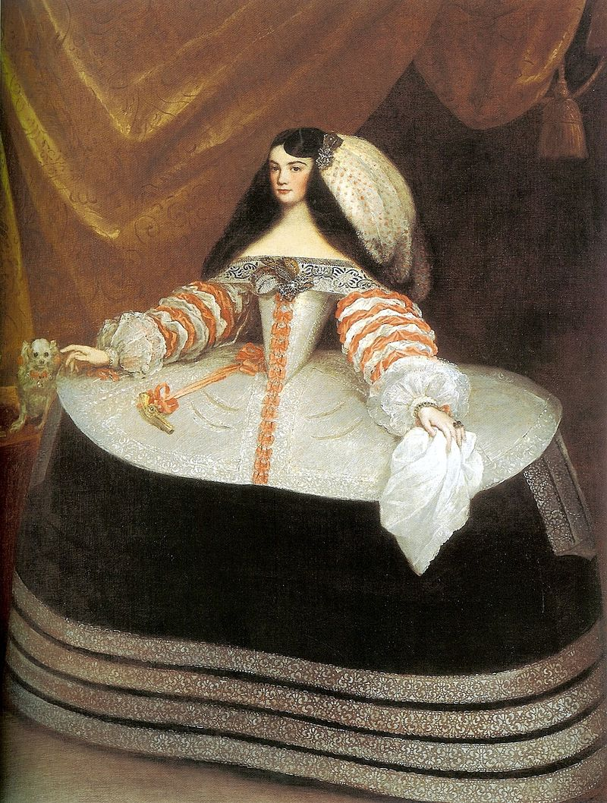
The Comedy of Manners
The target of most plays is the Upper Class. Playwrights focus on lavish, shallow, self-obsessed and materialistic nature of the rich.
Notes:
Most often the upper classes and their materialistic and shallow approach to life

Slide 3
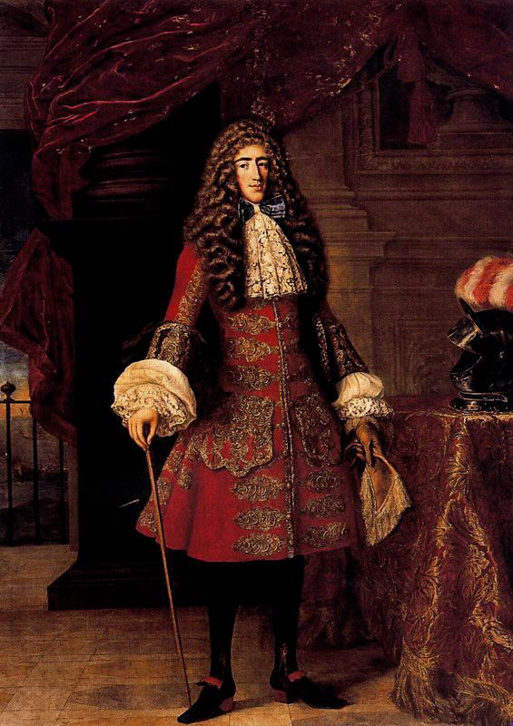
The Comedy of Manners
Playwrights also focus on the “codes” of this group and how that defines their behavior.
Notes:
Most often the upper classes and their materialistic and shallow approach to life

Slide 4
The Comedy of Manners
Playwrights also focus on the “codes” of this group and how that defines their behaviour.
We can’t do that! We wouldn’t say that! We must talk like this!
Notes:
Most often the upper classes and their materialistic and shallow approach to life

Slide 5
The Comedy of Manners
Plays emphasize verbal comedy over physical comedy.
Extensive use of wit was key: quips, retorts, repartee, puns, innuendo, and satire.
Characters are clever or at the mercy of someone clever.

Slide 6
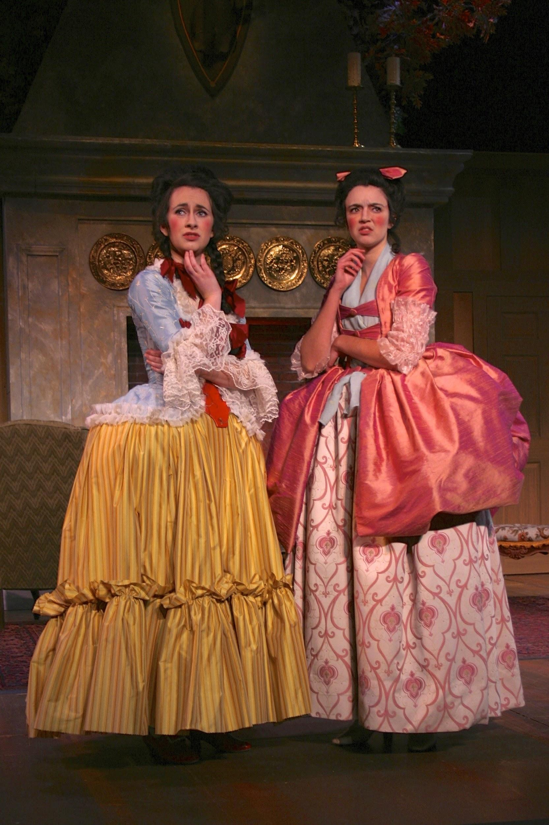
The Comedy of Manners
She Stoops To Conquer
By Oliver Goldsmith 1771
Mrs HARDCASTLE: Indeed, Constance, you amaze me. Such a girl as you want jewels! It will be time enough for jewels, my dear, twenty years hence, when your beauty begins to want repairs.
MISS NEVILLE: But what will repair beauty at forty, will certainly improve it at twenty, madam.
Uark Theatre

Slide 7
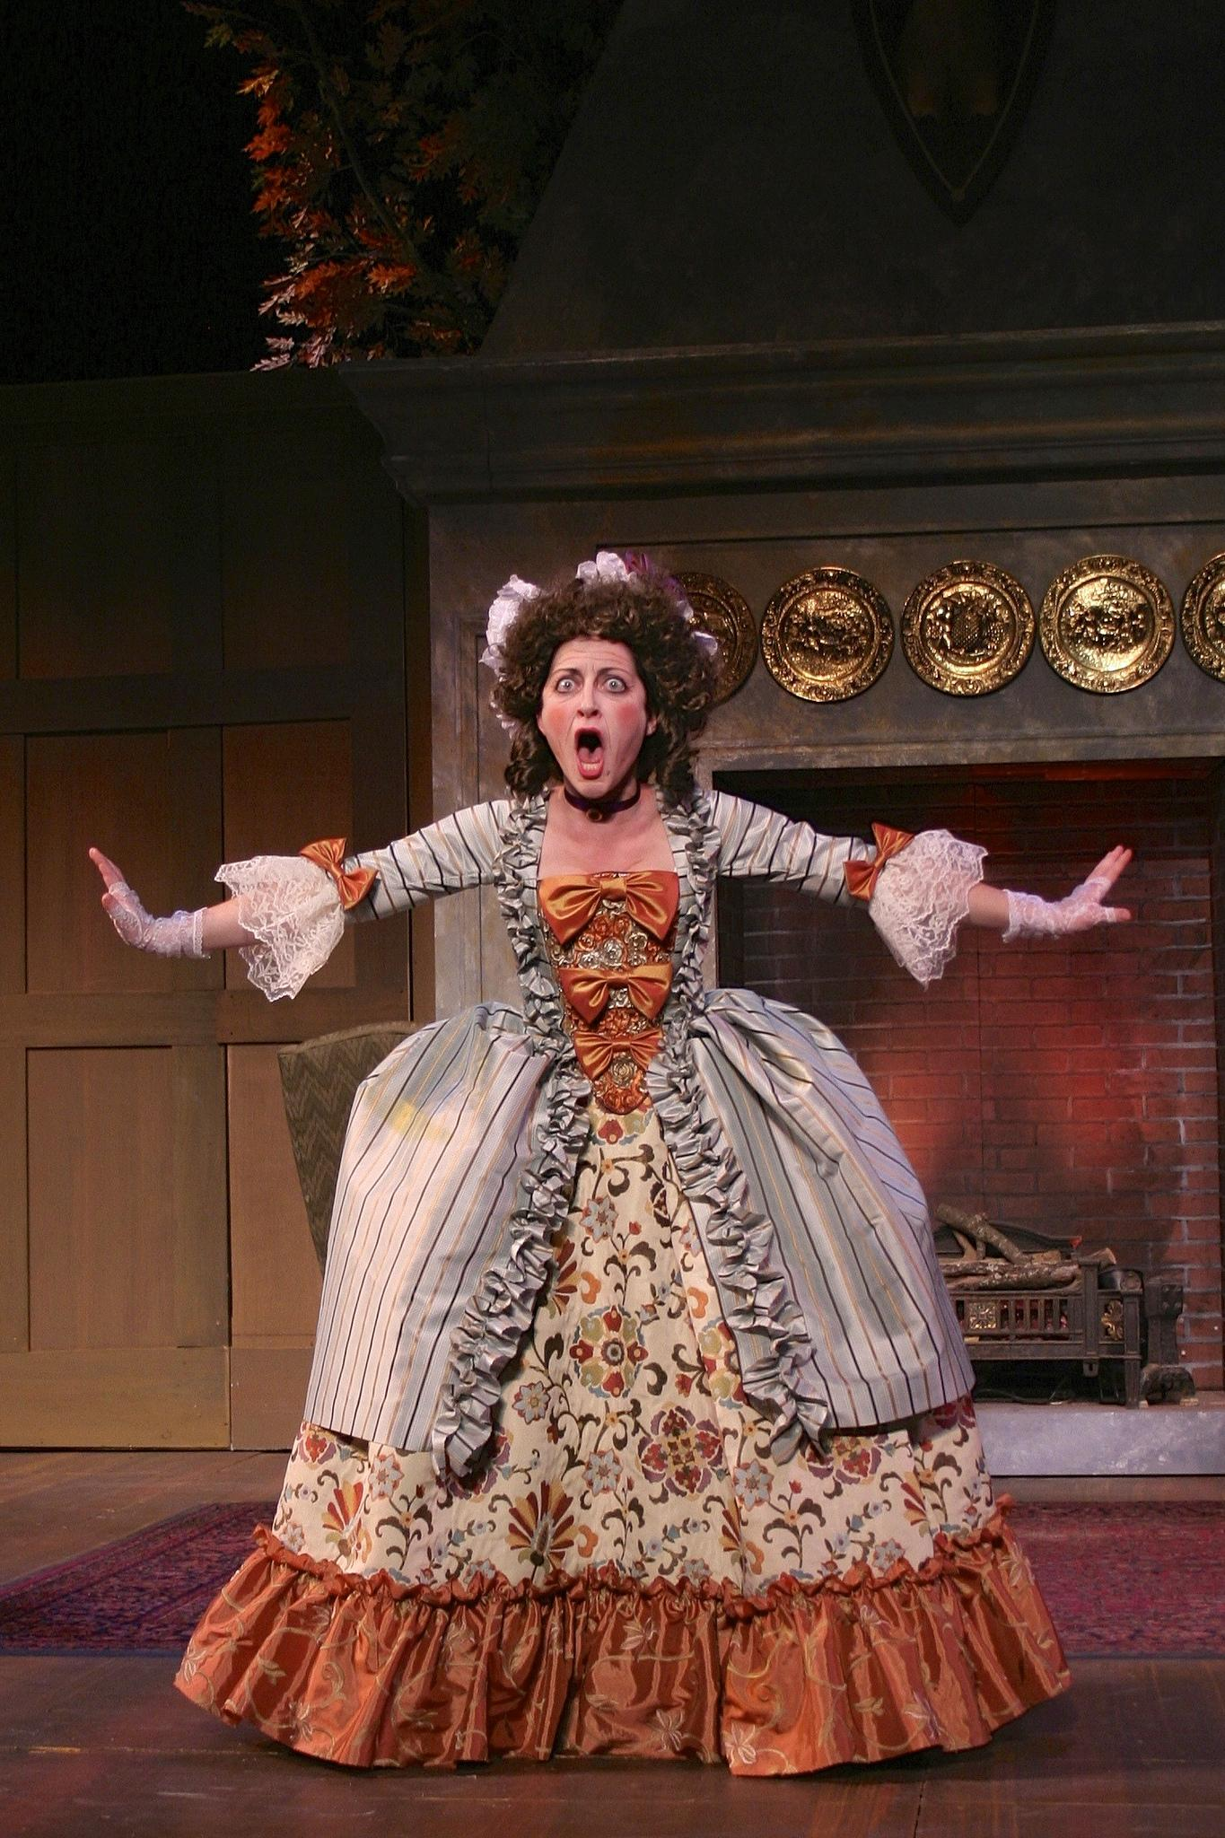
The Comedy of Manners
Themes:
Love and marriage, but corrupt versions: faithfulness not respected, adultery and immoral behavior encouraged.
Uark Theatre

Slide 8
The Comedy of Manners
Other Themes:
Money and materialism
Fashion and the artificial
Social standards
Rural vs urban
Moral weakness
Gossip and scandal
Uark Theatre

Slide 9
The Comedy of Manners
Plots:
Often centred on a love story
Complicated with a lot of twists
Miscommunications
Always a happy ending
Real situations and locations
Uark Theatre

Slide 10
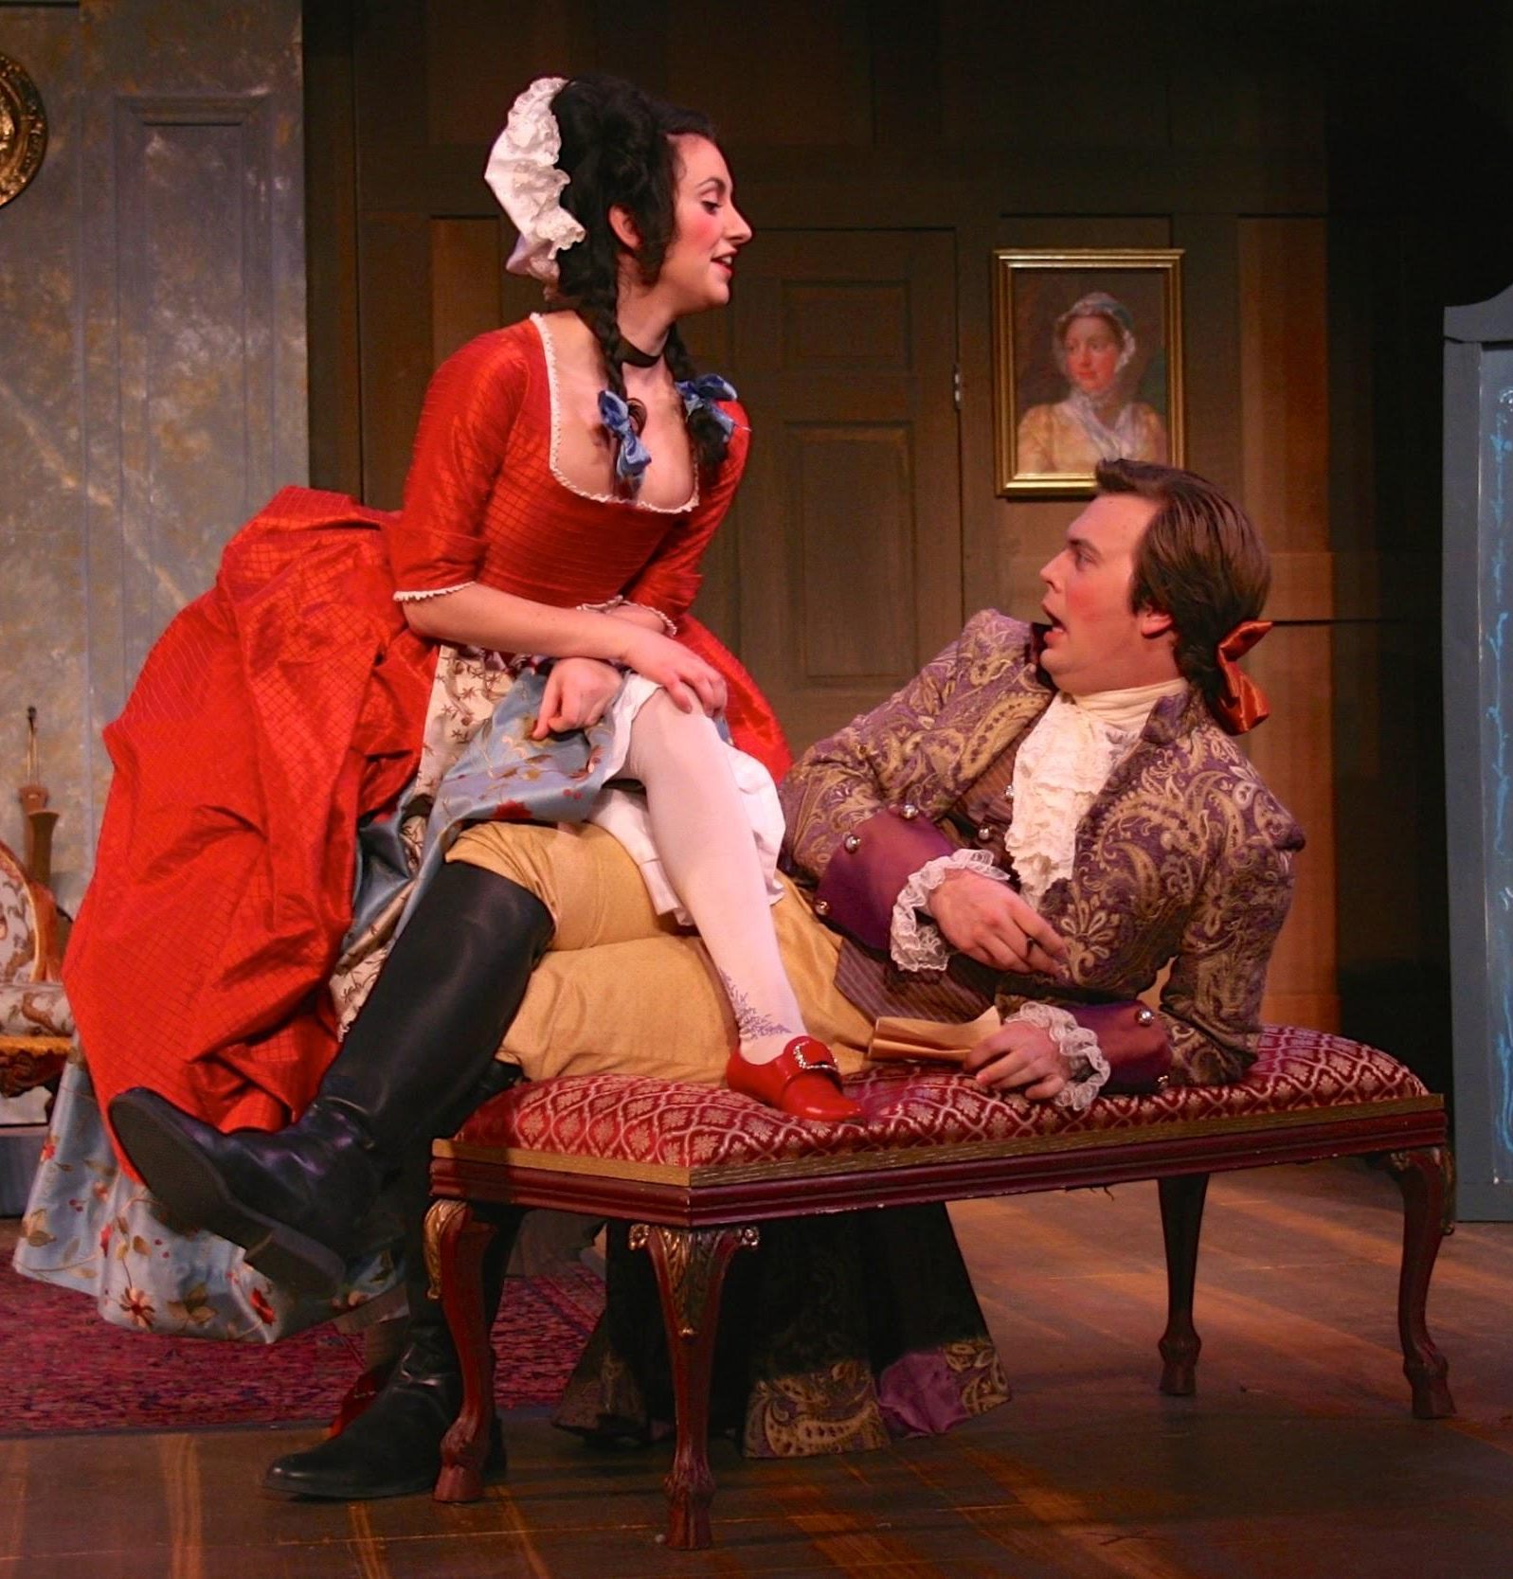
The Comedy of Manners
Characters:
Characters are types with one focus and rarely change. Their names often reveal their personality:
Mr Sparkish, Dainty Fidget, Old Lady Squeamish, Harry Horner
The Country Wife, William Wycherley, 1675
Uark Theatre

Slide 11
The Comedy of Manners
Character Types:
Rakes, fops, country-bumpkins, shrewd widows, young lovers, old lovers, jealous husbands, bold women, fools, schemers, meddling parents, cuckolds, know-it-alls, rogues, young maids, gossips, wits, would-be-wits, and the witless!
Uark Theatre

Slide 12
Background

Slide 13
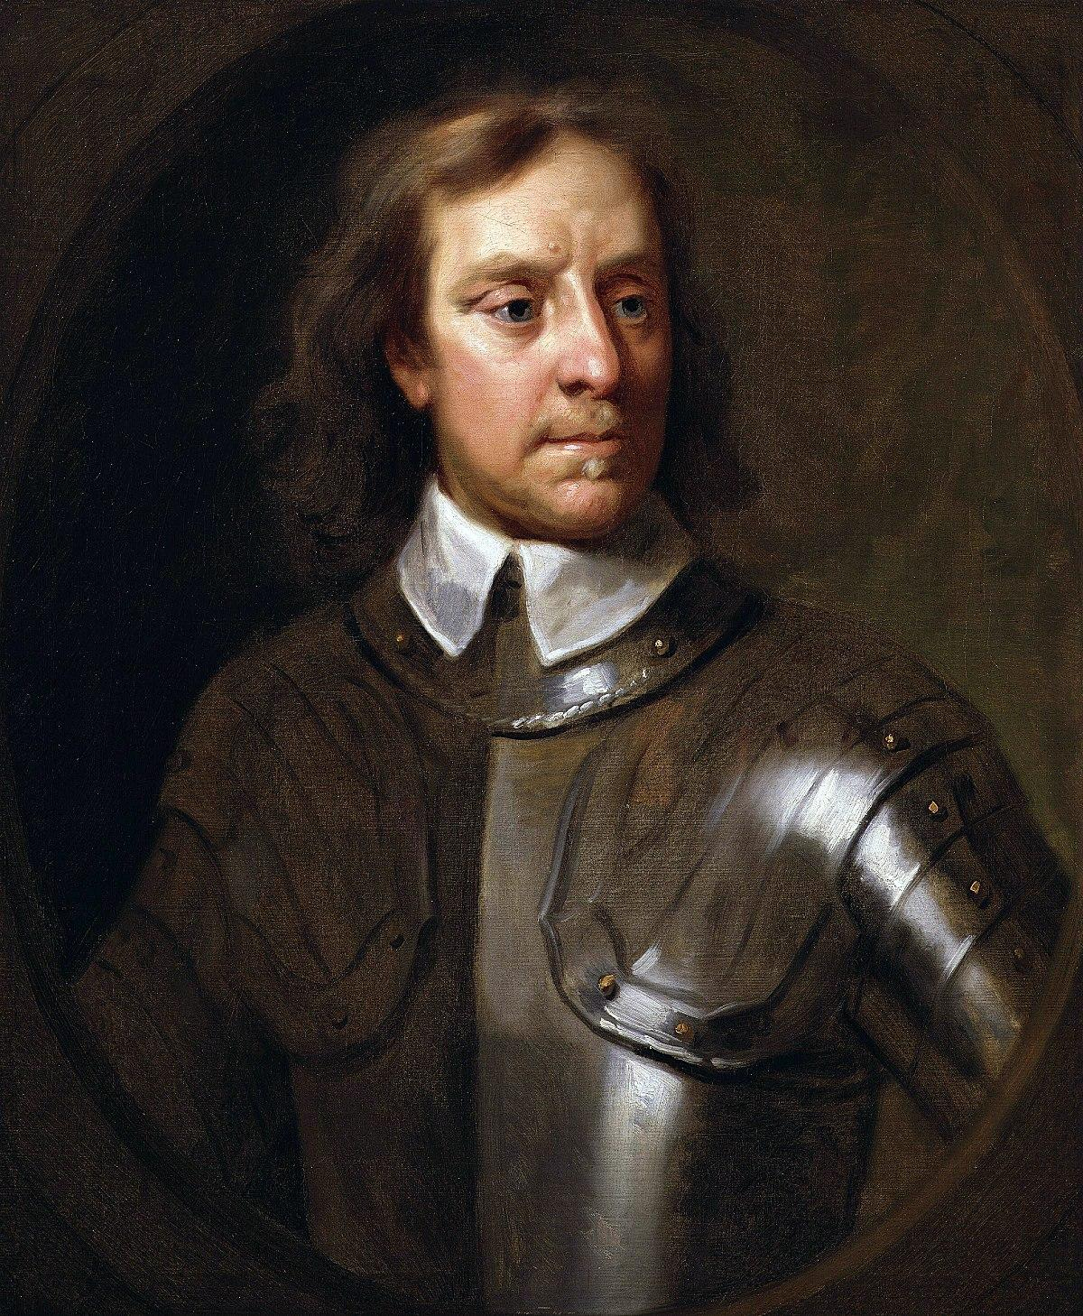
The Comedy of Manners
In England theatres were closed during the reign of Oliver Cromwell from 1642 to 1660.Theatre was seen as immoral and banned.
Uark Theatre

Slide 14
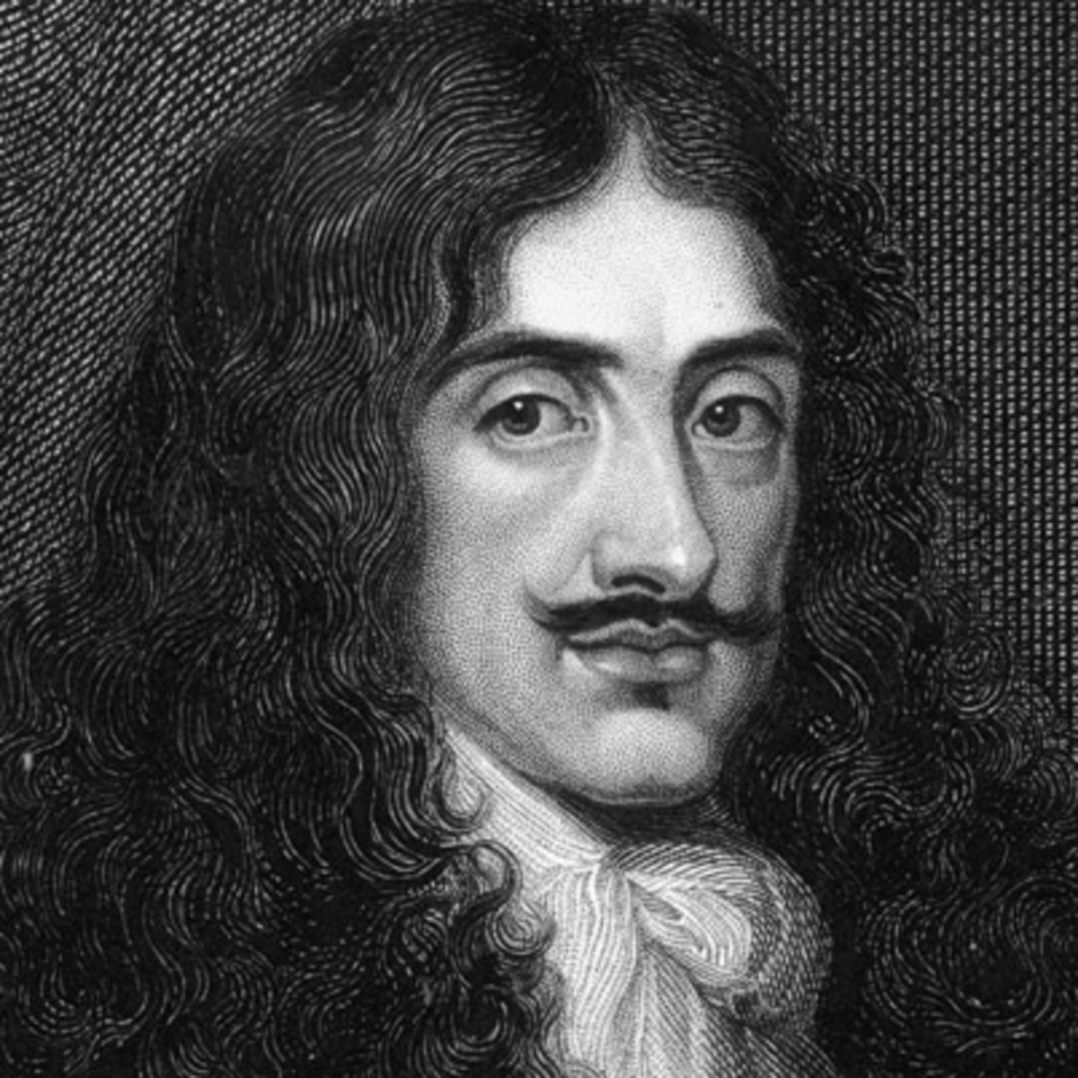
The Comedy of Manners
In England theatres were closed during the reign of Oliver Cromwell from 1643 to 1660.Theatre was seen as immoral and banned.
Even Shakespeare’s Globe Theatre was torn down!
Uark Theatre

Slide 15
The Comedy of Manners
Theatres reopened with the return of Charles II in 1660. He loved theatre and was highly influenced by what he saw during his exile in France in the court of Louis XIV.
Uark Theatre

Slide 16
The Comedy of Manners
This period was called The Restoration with the restoration of the monarchy.
Uark Theatre

Slide 17
The Comedy of Manners
Comedy of manners plays in this time were referred to as Restoration comedies.
Uark Theatre

Slide 18
Comedy of Manners Playwrights

Slide 19
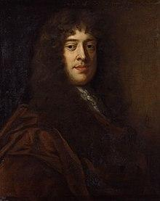
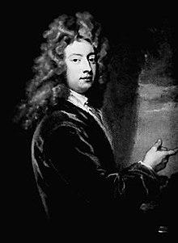
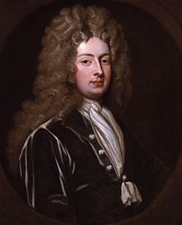
The Comedy of Manners
William Wycherley
The Country-Wife, 1675
George Etheridge
The Man of Mode, 1676
William Congreve
The Way of the World, 1700
Uark Theatre

Slide 20
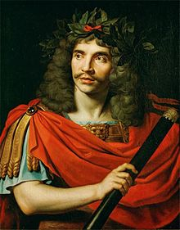
The Comedy of Manners
And over in France…Molière was also mocking the upper classes. Unfortunately, his plays were not as well received. He made enemies, especially in the church. The Archbishop threatened he would excommunicate anyone who saw, performed, or even read Tartuffe.
The School for Husbands (1661)
The School for Wives (1662)
Tartuffe (1664)
The Misanthrope (1666)
The Miser (1668)
The Bourgeois Gentleman (1670)
The Learned Ladies (1672)
The Imaginary Invalid (1673)
Molière
Uark Theatre

Slide 21
The Comedy of Manners
BUT!
The style and characteristics of the Comedy of Manners is not limited to this time period

Slide 22
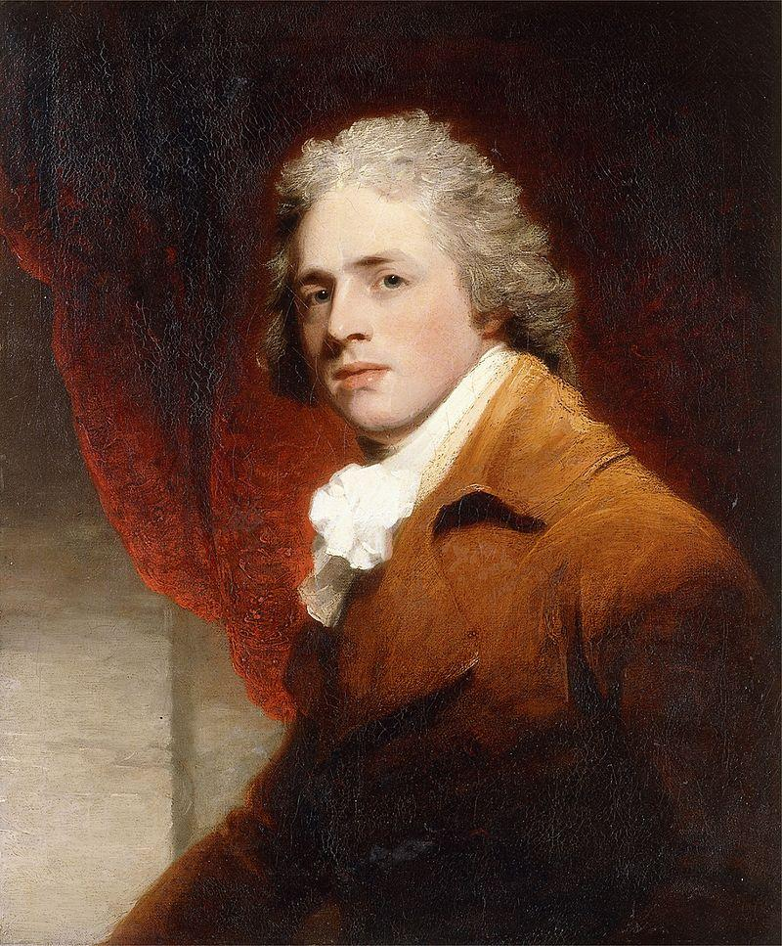
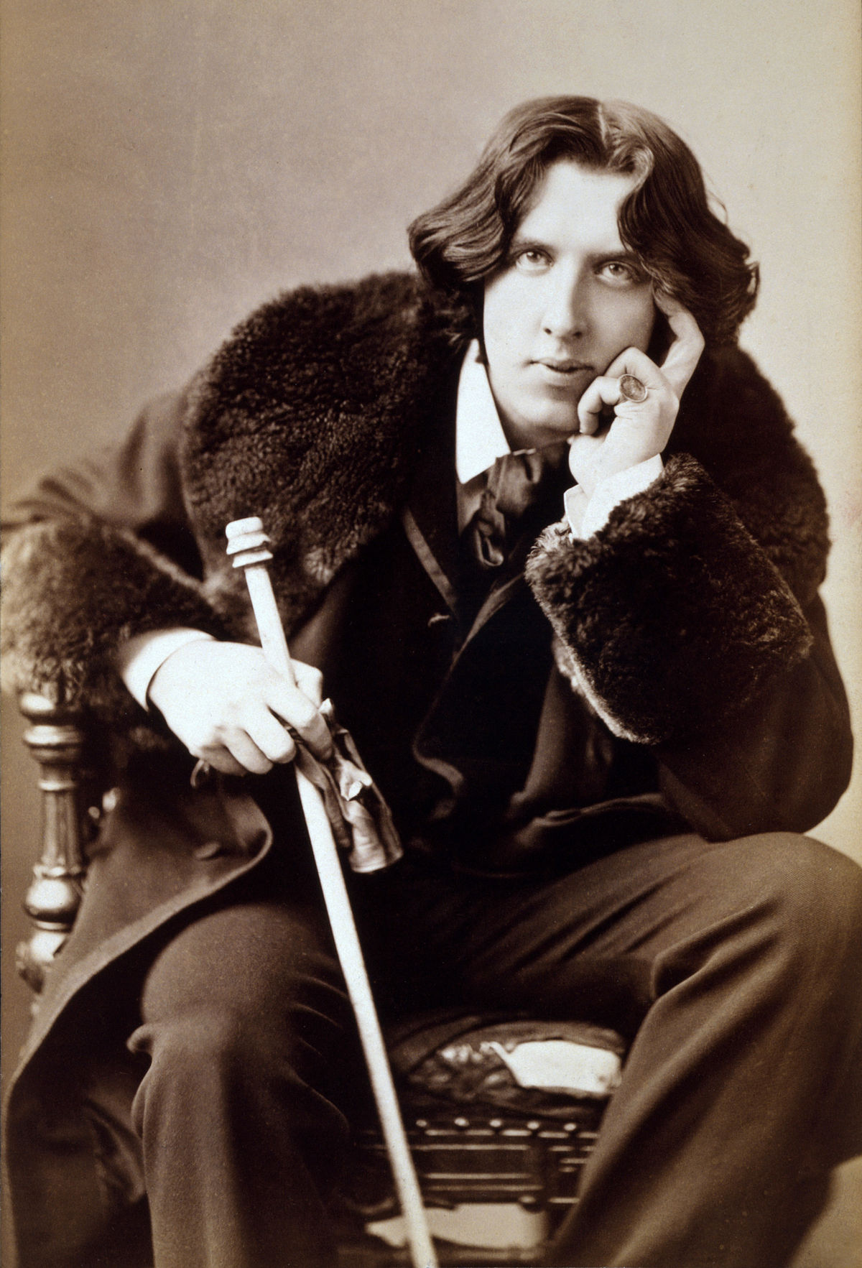
The Comedy of Manners
Richard Sheridan
The School for Scandal, 1777
Oscar Wilde
The Importance of Being Earnest, 1895
Uark Theatre

Slide 23
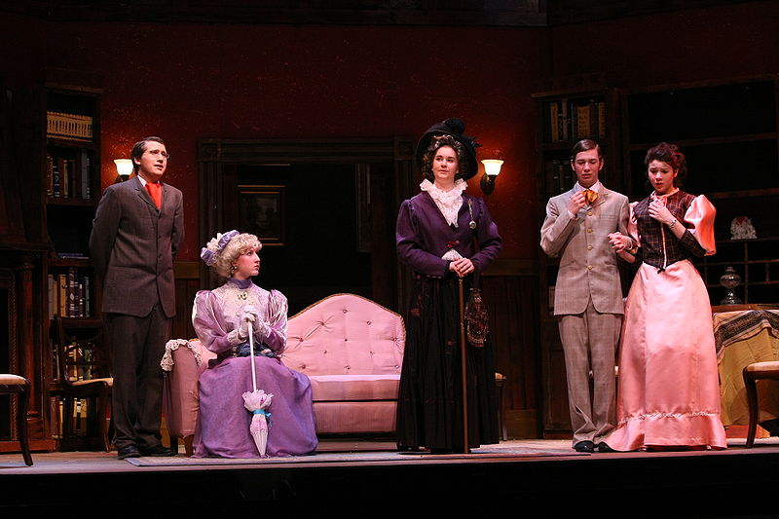
The Comedy of Manners
We will be using The Importance of Being Earnest throughout this unit as an illustration of the comedy of manners.
CHS Theatre
Uark Theatre

Slide 24
The Comedy of Manners
Question:
Write down one
modern example of
comedy of manners.
Uark Theatre

Slide 25
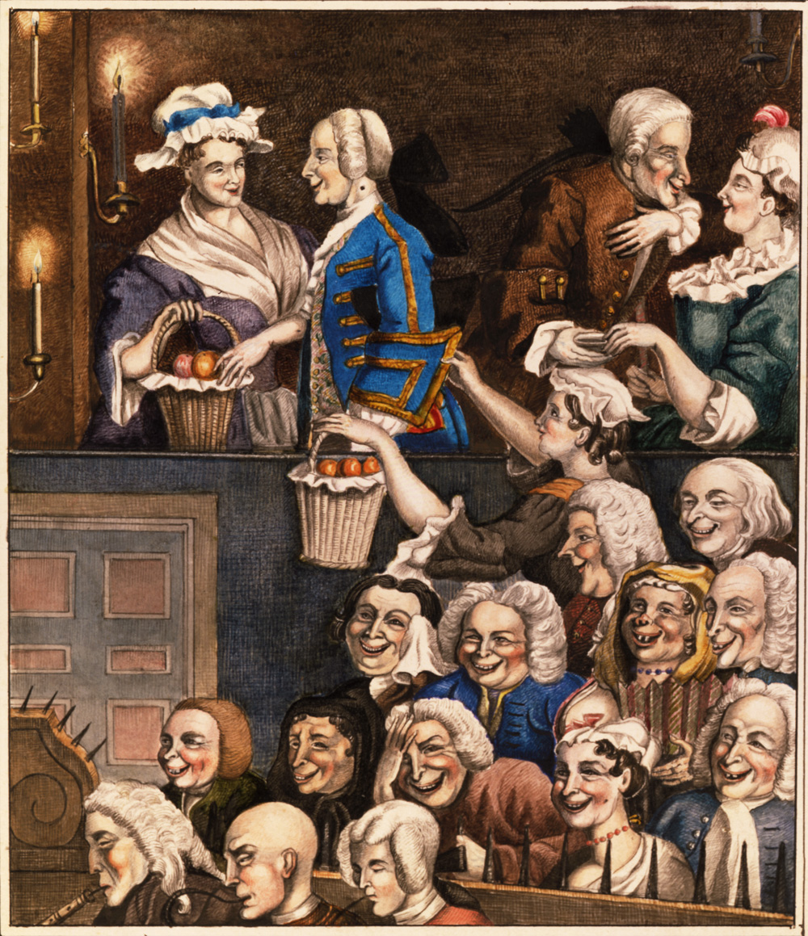
The Comedy of Manners
Reflect on this statement:
Comedy of Manners plays act as a mirror. They take the characteristics of those in their audiences and reflect them back.
Uark Theatre

