Slide 1
Elements of Design

Slide 2
Drama - Direction (emphasis) Students - Shape Like - Line To - Tone (mood) Create - Color Silly - Space Theatre - Texture

Slide 3
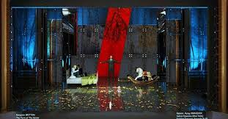
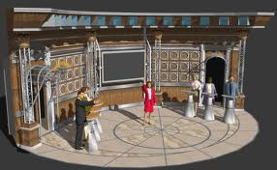
DIRECTION (EMPHASIS)
Where do you want the audience to look?

Slide 4
SHAPE
______ – is outline, may be geometric or free-form, natural or stylized, realistic or impressionistic

Slide 5
SHAPE
Shape – is outline, may be geometric or free-form, natural or stylized, realistic or impressionistic

Slide 6
SHAPE
Shape – is outline, may be geometric or free-form, natural or stylized, realistic or impressionistic
More form fitting – upper class

Slide 7
SHAPE
Shape – is outline, may be geometric or free-form, natural or stylized, realistic or impressionistic
More form fitting – upper class
Looser – lower class

Slide 8
SHAPE
Shape – is outline, may be geometric or free-form, natural or stylized, realistic or impressionistic
More form fitting – upper class
Looser – lower class
Consider psychological influences
______ – infinite, eternal, feminine
__________– unmovable, unimaginative
_________ – uplifting, secure foundation
________– calming, restful, wealth

Slide 9
SHAPE
Shape – is outline, may be geometric or free-form, natural or stylized, realistic or impressionistic
More form fitting – upper class
Looser – lower class
Consider psychological influences
Circle– infinite, eternal, feminine
__________– unmovable, unimaginative
_________ – uplifting, secure foundation
________– calming, restful, wealth

Slide 10
SHAPE
Shape – is outline, may be geometric or free-form, natural or stylized, realistic or impressionistic
More form fitting – upper class
Looser – lower class
Consider psychological influences
Circle– infinite, eternal, feminine
Square/cube– unmovable, unimaginative
_________ – uplifting, secure foundation
________– calming, restful, wealth

Slide 11
SHAPE
Shape – is outline, may be geometric or free-form, natural or stylized, realistic or impressionistic
More form fitting – upper class
Looser – lower class
Consider psychological influences
Circle– infinite, eternal, feminine
Square/cube– unmovable, unimaginative
Triangle – uplifting, secure foundation
________– calming, restful, wealth

Slide 12
SHAPE
Shape – is outline, may be geometric or free-form, natural or stylized, realistic or impressionistic
More form fitting – upper class
Looser – lower class
Consider psychological influences
Circle – infinite, eternal, feminine
Square/cube – unmovable, unimaginative
Triangle – uplifting, secure foundation
Diamond – calming, restful, wealth

Slide 13
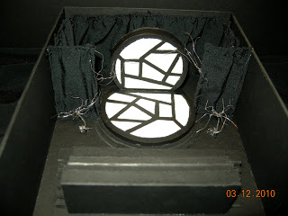
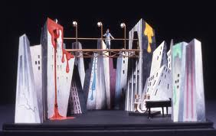
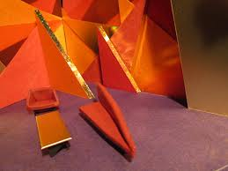
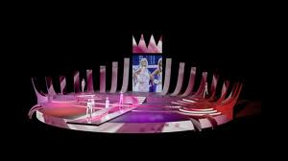

Slide 14
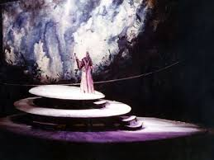
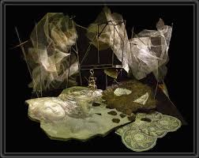

Slide 16
LINE
Different lines cause different psychological connotations:
*____________ – Dignity, elevation, hope, spirituality

Slide 17
LINE
Different lines cause different psychological connotations:
* Long Vertical lines – Dignity, elevation, hope, spirituality

Slide 18
LINE
Different lines cause different psychological connotations:
* Long Vertical lines – Dignity, elevation, hope, spirituality
* ___________ – emotional stability, calmness, tranquility

Slide 19
LINE
Different lines cause different psychological connotations:
* Long Vertical lines – Dignity, elevation, hope, spirituality
* Horizontal lines – emotional stability, calmness, tranquility

Slide 20
LINE
Different lines cause different psychological connotations:
* Long Vertical lines – Dignity, elevation, hope, spirituality
* Horizontal lines – emotional stability, calmness, tranquility
*___________ – driving force, strife, uncertainty, concentration

Slide 21
LINE
Different lines cause different psychological connotations:
* Long Vertical lines – Dignity, elevation, hope, spirituality
* Horizontal lines – emotional stability, calmness, tranquility
* Diagonal lines – driving force, strife, uncertainty, concentration

Slide 22
LINE
Different lines cause different psychological connotations:
* Long Vertical lines – Dignity, elevation, hope, spirituality
* Horizontal lines – emotional stability, calmness, tranquility
* Diagonal lines – driving force, strife, uncertainty, concentration
*____________ – ease, comfort, wealth, expanse

Slide 23
LINE
Different lines cause different psychological connotations:
* Long Vertical lines – Dignity, elevation, hope, spirituality
* Horizontal lines – emotional stability, calmness, tranquility
* Diagonal lines – driving force, strife, uncertainty, concentration
* Curved lines – ease, comfort, wealth, expanse

Slide 24
LINE
Different lines cause different psychological connotations:
* Long Vertical lines – Dignity, elevation, hope, spirituality
* Horizontal lines – emotional stability, calmness, tranquility
* Diagonal lines – driving force, strife, uncertainty, concentration
* Curved lines – ease, comfort, wealth, expanse
*__________ – chaos, shattered dreams, injustice, pain

Slide 25
LINE
Different lines cause different psychological connotations:
* Long Vertical lines – Dignity, elevation, hope, spirituality
* Horizontal lines – emotional stability, calmness, tranquility
* Diagonal lines – driving force, strife, uncertainty, concentration
* Curved lines – ease, comfort, wealth, expanse
* Crooked/jagged lines – chaos, shattered dreams, injustice, pain

Slide 26
LINE
Different lines cause different psychological connotations:
* Long Vertical lines – Dignity, elevation, hope, spirituality
* Horizontal lines – emotional stability, calmness, tranquility
* Diagonal lines – driving force, strife, uncertainty, concentration
* Curved lines – ease, comfort, wealth, expanse
* Crooked/jagged lines – chaos, shattered dreams, injustice, pain
*__________ – intense excitement (if combined with contrasting colors)

Slide 27
LINE
Different lines cause different psychological connotations:
* Long Vertical lines – Dignity, elevation, hope, spirituality
* Horizontal lines – emotional stability, calmness, tranquility
* Diagonal lines – driving force, strife, uncertainty, concentration
* Curved lines – ease, comfort, wealth, expanse
* Crooked/jagged lines – chaos, shattered dreams, injustice, pain
* Curves & angles – intense excitement (if combined with contrasting colors)

Slide 28
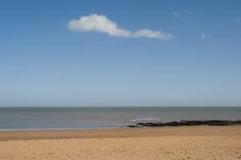
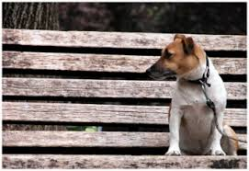
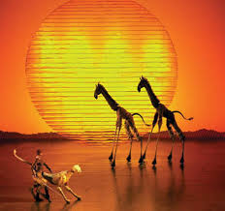
Horizontal
Lines

Slide 29
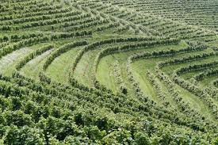
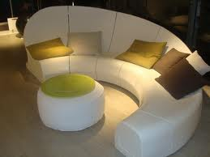
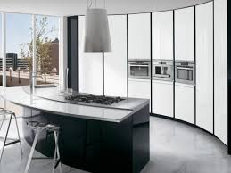
Curved
Lines

Slide 30
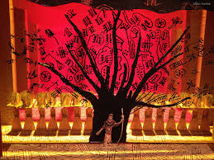
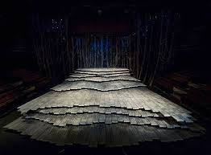
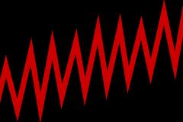
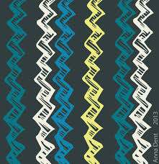
V E R T I C A L
L I N E S
J
A
G
G
E
D
L
I
N
E
S

Slide 31
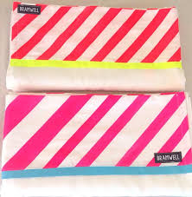
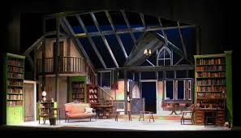
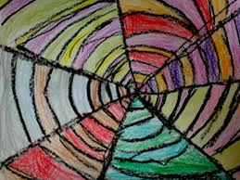
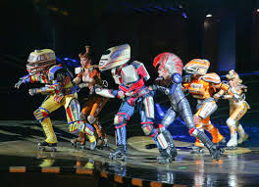
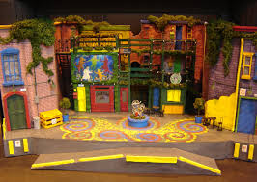
Diagonal Lines
Curves and Angles

Slide 32
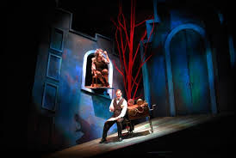
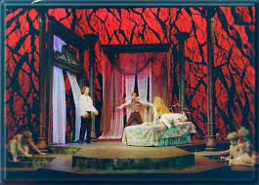
TONE (MOOD)
______ – the emotional feeling of the play the audience experiences
Affected by all the technical elements combined

Slide 33
TONE (MOOD)
Mood – the emotional feeling of the play the audience experiences
*Affected by all the technical elements combined

Slide 34
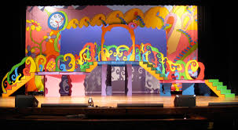
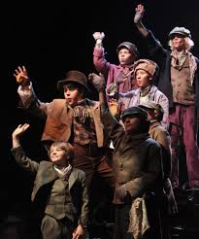
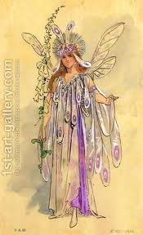
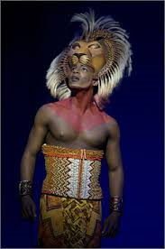
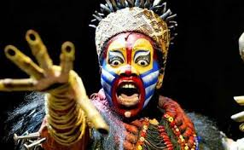

Slide 35
COLOR
Make sure the colors of all different production areas are working together to produce the effect that the director wants.
Note - Lighting can change the color of your set and costumes!

Slide 36
COLOR
Make sure the colors of all different production areas are working together to produce the effect that the director wants.
Note - Lighting can change the color of your set and costumes!
______ – the lightness or darkness of a color (tints vs. shades)
_____ – (pastels)have more white, suggest youth, comedy , informality
______ – have more black, suggest dignity, seriousness

Slide 37
COLOR
Make sure the colors of all different production areas are working together to produce the effect that the director wants.
Note - Lighting can change the color of your set and costumes!
Value – the lightness or darkness of a color (tints vs. shades)
______ – (pastels)have more white, suggest youth, comedy , informality
______ – have more black, suggest dignity, seriousness

Slide 38
COLOR
Make sure the colors of all different production areas are working together to produce the effect that the director wants.
Note - Lighting can change the color of your set and costumes!
Value – the lightness or darkness of a color (tints vs. shades)
Tints – (pastels)have more white, suggest youth, comedy , informality
______ – have more black, suggest dignity, seriousness

Slide 39
COLOR
Make sure the colors of all different production areas are working together to produce the effect that the director wants.
Note - Lighting can change the color of your set and costumes!
Value – the lightness or darkness of a color (tints vs. shades)
Tints – (pastels)have more white, suggest youth, comedy , informality
Shades – have more black, suggest dignity, seriousness

Slide 40
COLOR
Make sure the colors of all different production areas are working together to produce the effect that the director wants.
Note - Lighting can change the color of your set and costumes!
Value – the lightness or darkness of a color (tints vs. shades)
Tints – (pastels)have more white, suggest youth, comedy , informality
Shades – have more black, suggest dignity, seriousness
______ – the pureness of a color

Slide 41
COLOR
Make sure the colors of all different production areas are working together to produce the effect that the director wants.
Note - Lighting can change the color of your set and costumes!
Value – the lightness or darkness of a color (tints vs. shades)
Tints – (pastels)have more white, suggest youth, comedy , informality
Shades – have more black, suggest dignity, seriousness
Hue – the pureness of a color

Slide 42
COLOR
Make sure the colors of all different production areas are working together to produce the effect that the director wants.
Note - Lighting can change the color of your set and costumes!
Value – the lightness or darkness of a color (tints vs. shades)
Tints – (pastels)have more white, suggest youth, comedy , informality
Shades – have more black, suggest dignity, seriousness
Hue – the pureness of a color
_____________ – the brightness or dullness of a color
Warm colors advance – Red, Orange, yellow (stimulating, exciting, comedies)
Cool colors recede – Blue, Green, Violet (tranquility, calm, serious
Different colors express different ideas:

Slide 43
COLOR
Make sure the colors of all different production areas are working together to produce the effect that the director wants.
Note - Lighting can change the color of your set and costumes!
Value – the lightness or darkness of a color (tints vs. shades)
Tints – (pastels)have more white, suggest youth, comedy , informality
Shades – have more black, suggest dignity, seriousness
Hue – the pureness of a color
Intensity (saturation) – the brightness or dullness of a color
Warm colors advance – Red, Orange, yellow (stimulating, exciting, comedies)
Cool colors recede – Blue, Green, Violet (tranquility, calm, serious
Different colors express different ideas:

Slide 44
______ – calm, cold, formal, spiritual, pure, truthful, depressing

Slide 45
Blue – calm, cold, formal, spiritual, pure, truthful, depressing

Slide 46
Blue – calm, cold, formal, spiritual, pure, truthful, depressing
_______ – exhilarating, cheerful, lively

Slide 47
Blue – calm, cold, formal, spiritual, pure, truthful, depressing
Orange – exhilarating, cheerful, lively

Slide 48
Blue – calm, cold, formal, spiritual, pure, truthful, depressing
Orange – exhilarating, cheerful, lively
______ – aggressive, passionate, bloody, angry, strong

Slide 49
Blue – calm, cold, formal, spiritual, pure, truthful, depressing
Orange – exhilarating, cheerful, lively
Red – aggressive, passionate, bloody, angry, strong

Slide 50
Blue – calm, cold, formal, spiritual, pure, truthful, depressing
Orange – exhilarating, cheerful, lively
Red – aggressive, passionate, bloody, angry, strong
______ – cheerful, happy, youthful, cowardly

Slide 51
Blue – calm, cold, formal, spiritual, pure, truthful, depressing
Orange – exhilarating, cheerful, lively
Red – aggressive, passionate, bloody, angry, strong
Yellow – cheerful, happy, youthful, cowardly

Slide 52
Blue – calm, cold, formal, spiritual, pure, truthful, depressing
Orange – exhilarating, cheerful, lively
Red – aggressive, passionate, bloody, angry, strong
Yellow – cheerful, happy, youthful, cowardly
______ – fanciful, romantic

Slide 53
Blue – calm, cold, formal, spiritual, pure, truthful, depressing
Orange – exhilarating, cheerful, lively
Red – aggressive, passionate, bloody, angry, strong
Yellow – cheerful, happy, youthful, cowardly
Pink – fanciful, romantic

Slide 54
Blue – calm, cold, formal, spiritual, pure, truthful, depressing
Orange – exhilarating, cheerful, lively
Red – aggressive, passionate, bloody, angry, strong
Yellow – cheerful, happy, youthful, cowardly
Pink – fanciful, romantic
______ – youthful, eternal, reborn, jealous

Slide 55
Blue – calm, cold, formal, spiritual, pure, truthful, depressing
Orange – exhilarating, cheerful, lively
Red – aggressive, passionate, bloody, angry, strong
Yellow – cheerful, happy, youthful, cowardly
Pink – fanciful, romantic
Green – youthful, eternal, reborn, jealous

Slide 56
Blue – calm, cold, formal, spiritual, pure, truthful, depressing
Orange – exhilarating, cheerful, lively
Red – aggressive, passionate, bloody, angry, strong
Yellow – cheerful, happy, youthful, cowardly
Pink – fanciful, romantic
Green – youthful, eternal, reborn, jealous
_______ – restful, soothing, tranquil

Slide 57
Blue – calm, cold, formal, spiritual, pure, truthful, depressing
Orange – exhilarating, cheerful, lively
Red – aggressive, passionate, bloody, angry, strong
Yellow – cheerful, happy, youthful, cowardly
Pink – fanciful, romantic
Green – youthful, eternal, reborn, jealous
Soft Green – restful, soothing, tranquil

Slide 58
Blue – calm, cold, formal, spiritual, pure, truthful, depressing
Orange – exhilarating, cheerful, lively
Red – aggressive, passionate, bloody, angry, strong
Yellow – cheerful, happy, youthful, cowardly
Pink – fanciful, romantic
Green – youthful, eternal, reborn, jealous
Soft Green – restful, soothing, tranquil
______ – mournful, mystic, regal

Slide 59
Blue – calm, cold, formal, spiritual, pure, truthful, depressing
Orange – exhilarating, cheerful, lively
Red – aggressive, passionate, bloody, angry, strong
Yellow – cheerful, happy, youthful, cowardly
Pink – fanciful, romantic
Green – youthful, eternal, reborn, jealous
Soft Green – restful, soothing, tranquil
Purple – mournful, mystic, regal

Slide 60
Blue – calm, cold, formal, spiritual, pure, truthful, depressing
Orange – exhilarating, cheerful, lively
Red – aggressive, passionate, bloody, angry, strong
Yellow – cheerful, happy, youthful, cowardly
Pink – fanciful, romantic
Green – youthful, eternal, reborn, jealous
Soft Green – restful, soothing, tranquil
Purple – mournful, mystic, regal
_______ – neutral, depressing, negative, somber

Slide 61
Blue – calm, cold, formal, spiritual, pure, truthful, depressing
Orange – exhilarating, cheerful, lively
Red – aggressive, passionate, bloody, angry, strong
Yellow – cheerful, happy, youthful, cowardly
Pink – fanciful, romantic
Green – youthful, eternal, reborn, jealous
Soft Green – restful, soothing, tranquil
Purple – mournful, mystic, regal
Gray – neutral, depressing, negative, somber

Slide 62
Blue – calm, cold, formal, spiritual, pure, truthful, depressing
Orange – exhilarating, cheerful, lively
Red – aggressive, passionate, bloody, angry, strong
Yellow – cheerful, happy, youthful, cowardly
Pink – fanciful, romantic
Green – youthful, eternal, reborn, jealous
Soft Green – restful, soothing, tranquil
Purple – mournful, mystic, regal
Gray – neutral, depressing, negative, somber
_______ – earthy, common, poverty-stricken

Slide 63
Blue – calm, cold, formal, spiritual, pure, truthful, depressing
Orange – exhilarating, cheerful, lively
Red – aggressive, passionate, bloody, angry, strong
Yellow – cheerful, happy, youthful, cowardly
Pink – fanciful, romantic
Green – youthful, eternal, reborn, jealous
Soft Green – restful, soothing, tranquil
Purple – mournful, mystic, regal
Gray – neutral, depressing, negative, somber
Brown – earthy, common, poverty-stricken

Slide 64
Blue – calm, cold, formal, spiritual, pure, truthful, depressing
Orange – exhilarating, cheerful, lively
Red – aggressive, passionate, bloody, angry, strong
Yellow – cheerful, happy, youthful, cowardly
Pink – fanciful, romantic
Green – youthful, eternal, reborn, jealous
Soft Green – restful, soothing, tranquil
Purple – mournful, mystic, regal
Gray – neutral, depressing, negative, somber
Brown – earthy, common, poverty-stricken
______ – melancholic, tragic, gloomy, deathlike

Slide 65
Blue – calm, cold, formal, spiritual, pure, truthful, depressing
Orange – exhilarating, cheerful, lively
Red – aggressive, passionate, bloody, angry, strong
Yellow – cheerful, happy, youthful, cowardly
Pink – fanciful, romantic
Green – youthful, eternal, reborn, jealous
Soft Green – restful, soothing, tranquil
Purple – mournful, mystic, regal
Gray – neutral, depressing, negative, somber
Brown – earthy, common, poverty-stricken
Black – melancholic, tragic, gloomy, deathlike

Slide 66
Blue – calm, cold, formal, spiritual, pure, truthful, depressing
Orange – exhilarating, cheerful, lively
Red – aggressive, passionate, bloody, angry, strong
Yellow – cheerful, happy, youthful, cowardly
Pink – fanciful, romantic
Green – youthful, eternal, reborn, jealous
Soft Green – restful, soothing, tranquil
Purple – mournful, mystic, regal
Gray – neutral, depressing, negative, somber
Brown – earthy, common, poverty-stricken
Black – melancholic, tragic, gloomy, deathlike
_____ – truthful, pure, chaste, innocent, peaceful

Slide 67
Blue – calm, cold, formal, spiritual, pure, truthful, depressing
Orange – exhilarating, cheerful, lively
Red – aggressive, passionate, bloody, angry, strong
Yellow – cheerful, happy, youthful, cowardly
Pink – fanciful, romantic
Green – youthful, eternal, reborn, jealous
Soft Green – restful, soothing, tranquil
Purple – mournful, mystic, regal
Gray – neutral, depressing, negative, somber
Brown – earthy, common, poverty-stricken
Black – melancholic, tragic, gloomy, deathlike
White – truthful, pure, chaste, innocent, peaceful

Slide 69
SPACE
1. What type of theatre space is the performance in?
Proscenium, in the round, small theatre, large theatre

Slide 70
SPACE
1. What type of theatre space is the performance in?
Proscenium, in the round, small theatre, large theatre
Different sizes will require different design elements.

Slide 71
SPACE
1. What type of theatre space is the performance in?
Proscenium, in the round, small theatre, large theatre
Different sizes will require different design elements.
_________ – (measured by height of a human being)

Slide 72
SPACE
1. What type of theatre space is the performance in?
Proscenium, in the round, small theatre, large theatre
Different sizes will require different design elements.
Proportion – (measured by height of a human being)
_______ – equal distribution of emphasis

Slide 73
SPACE
1. What type of theatre space is the performance in?
Proscenium, in the round, small theatre, large theatre
Different sizes will require different design elements.
Proportion – (measured by height of a human being)
Balance – equal distribution of emphasis

Slide 74
SPACE
1. What type of theatre space is the performance in?
Proscenium, in the round, small theatre, large theatre
Different sizes will require different design elements.
Proportion – (measured by height of a human being)
Balance – equal distribution of emphasis
_____ – bulk and weight

Slide 75
SPACE
1. What type of theatre space is the performance in?
Proscenium, in the round, small theatre, large theatre
Different sizes will require different design elements.
Proportion – (measured by height of a human being)
Balance – equal distribution of emphasis
Mass – bulk and weight

Slide 76
SPACE
1. What type of theatre space is the performance in?
Proscenium, in the round, small theatre, large theatre
Different sizes will require different design elements.
Proportion – (measured by height of a human being)
Balance – equal distribution of emphasis
Mass – bulk and weight
2. What is the setting of the performance? Period, location, etc.

Slide 77
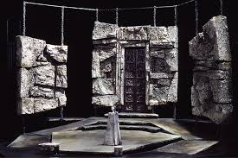
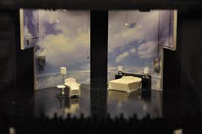
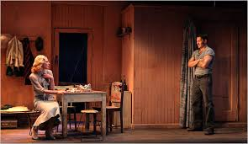
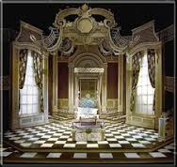

Slide 78
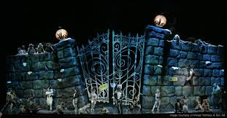
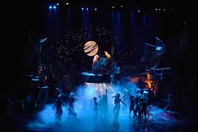
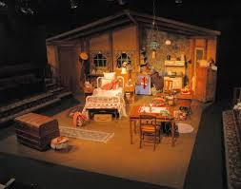

Slide 79
TEXTURE
_______ – the relative roughness or smoothness of an object

Slide 80
TEXTURE
Texture – the relative roughness or smoothness of an object

Slide 81
TEXTURE
Texture – the relative roughness or smoothness of an object
_______ – silk, satin, finished, ex. upper class, good guys

Slide 82
TEXTURE
Texture – the relative roughness or smoothness of an object
Smooth – silk, satin, finished, ex. upper class, good guys

Slide 83
TEXTURE
Texture – the relative roughness or smoothness of an object
Smooth – silk, satin, finished, ex. upper class, good guys
______ – burlap, bumpy, rocky, ex. Lower class, villains

Slide 84
TEXTURE
Texture – the relative roughness or smoothness of an object
Smooth – silk, satin, finished, ex. upper class, good guys
Rough – burlap, bumpy, rocky, ex. Lower class, villains

Slide 85
TEXTURE
Texture – the relative roughness or smoothness of an object
Smooth – silk, satin, finished, ex. upper class, good guys
Rough – burlap, bumpy, rocky, ex. Lower class, villains
_______ – lacy pattern, chiffon, fragile, vulnerable

Slide 86
TEXTURE
Texture – the relative roughness or smoothness of an object
Smooth – silk, satin, finished, ex. upper class, good guys
Rough – burlap, bumpy, rocky, ex. Lower class, villains
Delicate – lacy pattern, chiffon, fragile, vulnerable

Slide 87
TEXTURE
Texture – the relative roughness or smoothness of an object
Smooth – silk, satin, finished, ex. upper class, good guys
Rough – burlap, bumpy, rocky, ex. Lower class, villains
Delicate – lacy pattern, chiffon, fragile, vulnerable
________ – leather, fur, more rugged, sturdy

Slide 88
TEXTURE
Texture – the relative roughness or smoothness of an object
Smooth – silk, satin, finished, ex. upper class, good guys,
Rough – burlap, bumpy, rocky, ex. Lower class, villains
Delicate – lacy pattern, chiffon, fragile, vulnerable
Heavier – leather, fur, more rugged, sturdy

Slide 89
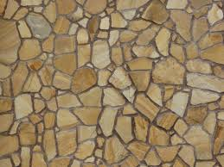
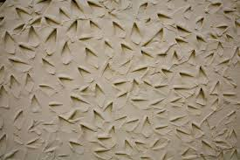
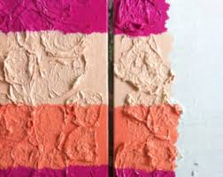
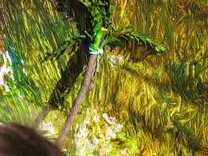
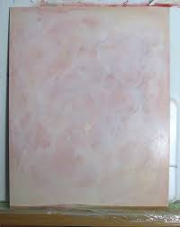
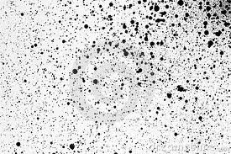

Slide 91
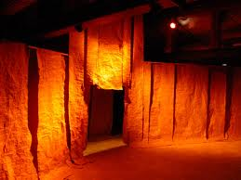

Slide 92
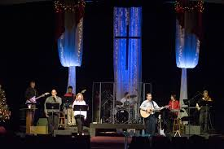
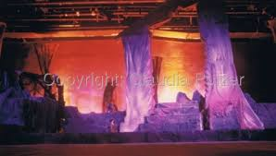
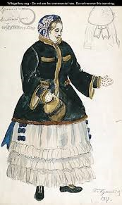
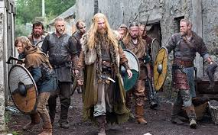
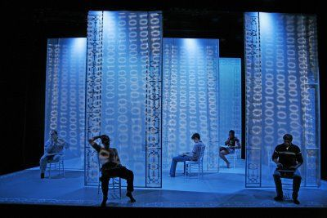

Slide 93
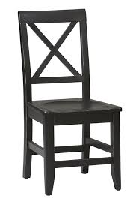
The director wants a chair…what kind ??
Direction
Shape
Line
Tone
Color
Space
Texture

